Slide 1
CounterFactuals
using
CDC Data RESULTS

Slide 2
WORKFLOW :
We have 5.0 GB of Birth Data File taken form “Centres for disease control and prevention (CDC)” datasets.
https://www.cdc.gov/nchs/data_access/vitalstatsonline.htm
Divide into 15 subfiles contains strings of 330.1 MB.
Preprocess these 15 sub-files to .csv files.
Combined all these 15 files. Each of (38744×214).
Chosen the useful columns from from these 214 columns.
71 Inputs columns,
Found that 62 columns which are useful.
61 Input Columns, 1 Output column as “Conditions”
Condition= ”1” means “No Abnormal Conditions”
Condition= ”0” means “Abnormal Conditions”.

Slide 3
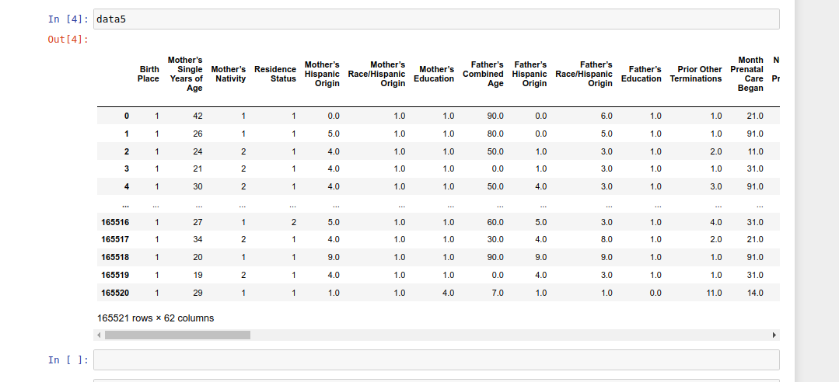
INPUT DATA :

Slide 4
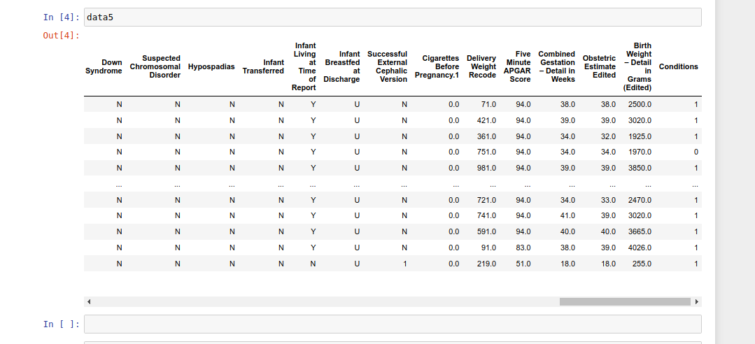
Output Target ( Conditions ) :
1 : No Abnormal Condition.
0 : Abnormal Condition.

Slide 5
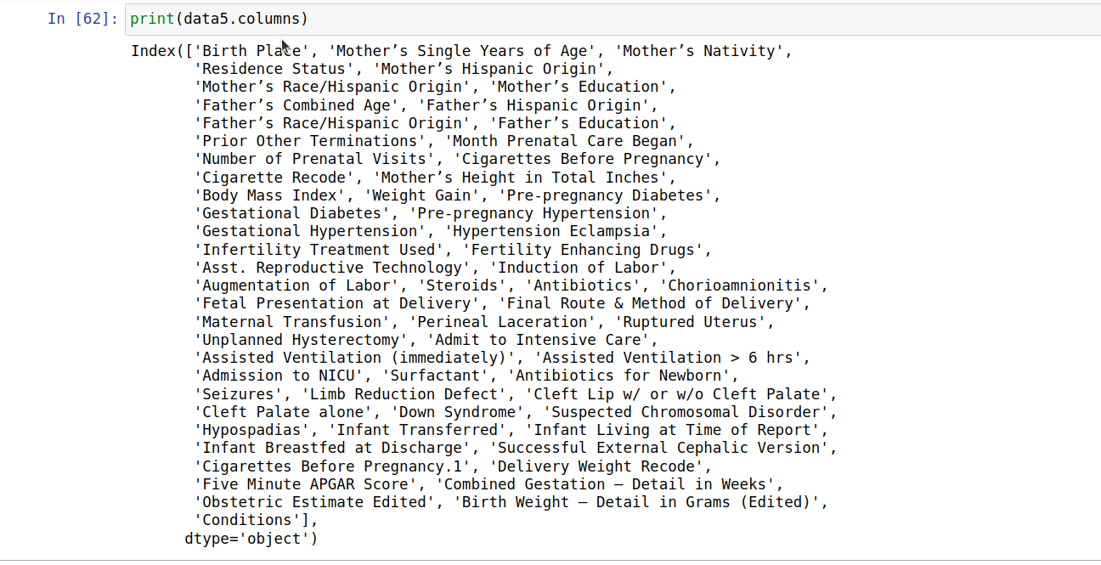
CATEGORICAL COLUMNS :
Categorical Columns are one-hot encoded for training.

Slide 6
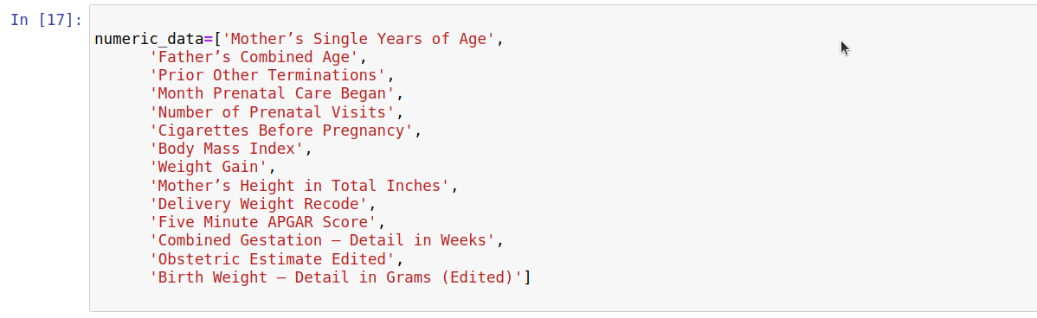
NUMERIC COLUMNS :
Numeric Values Changes during the CounterFactual Generations which Flip the class.

Slide 7
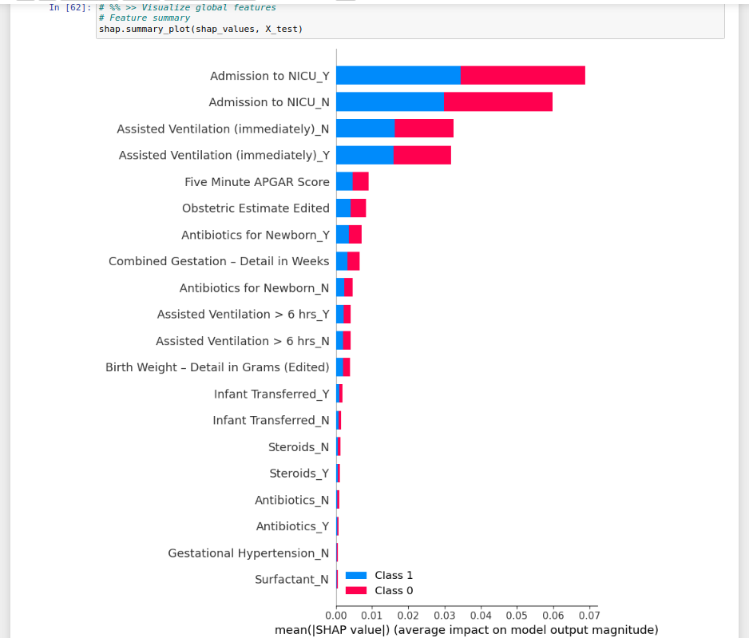
Detailed SHAP OUTPUT :
Top 5 Important Features = ( “Admission to NICU_Y”, “Assisted Ventilation”, “Five Minute APGAR Score”,”Anti-Biotics for NewBorn ”, “Combined Gestations”. )
Blue & Red occupy half of the Horizontal means that each feature has an equal impact on the classification of both No Abnormal Cond (label=1) and Normal Cond. (label=0) cases.

Slide 8
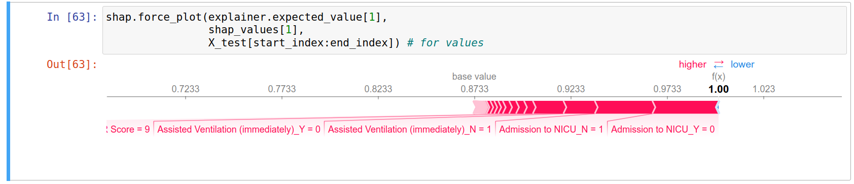
Force Plot for SHAP OUTPUT :
Top 3 Important Features and their values of importance for that class.
“Admission to NICU_Y”, Probability : 0.9733
“Assisted Ventilation”, Probability : 0.9233

Slide 9
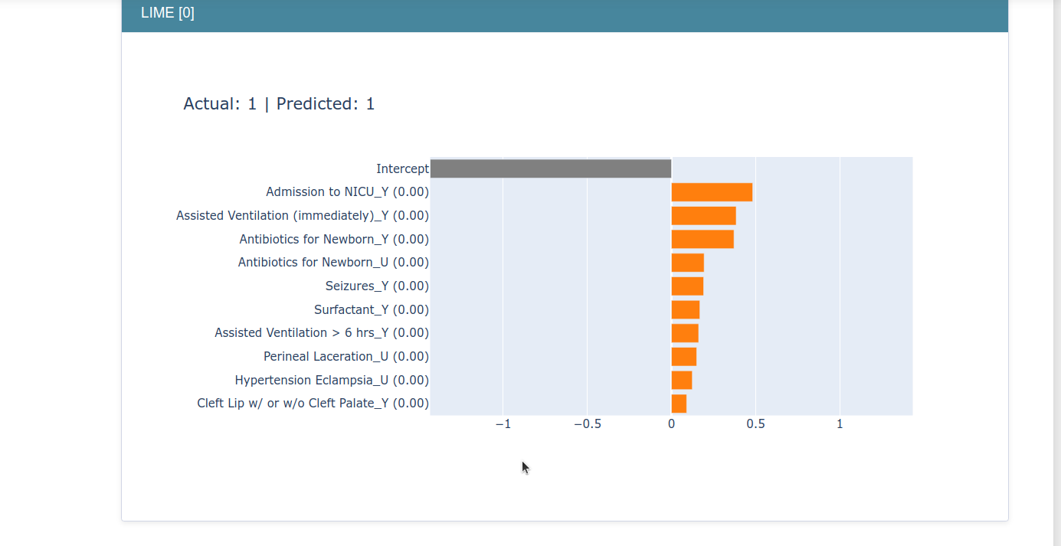
LIME OUTPUT :
“Admission to NICU_Y”, “Assisted Ventilation (immediately)”, Antibiotics for Newborn_Y are most contributing/important features as per “Local interpretation”. ( Every features contributing +ve values towards class 1 ).

Slide 10
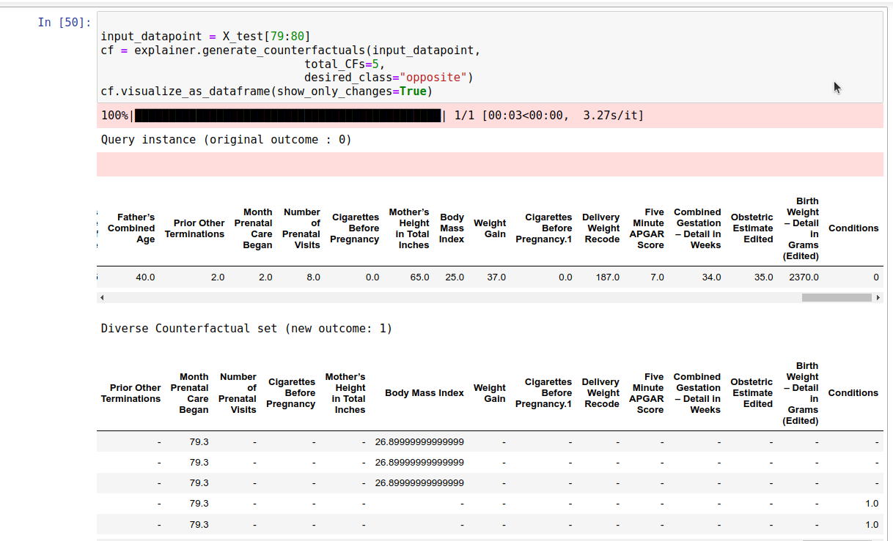
COUNTERFACTUAL GENERATIONS :
0 —> 1 ( Abnormal -> Normal ) CLASS CHANGE
Class changes : Presently Falling into Class “0” ( Abnormal Conditions ) ,But we want to predict “1” ( No Abnormal Conditions ) .

Slide 11
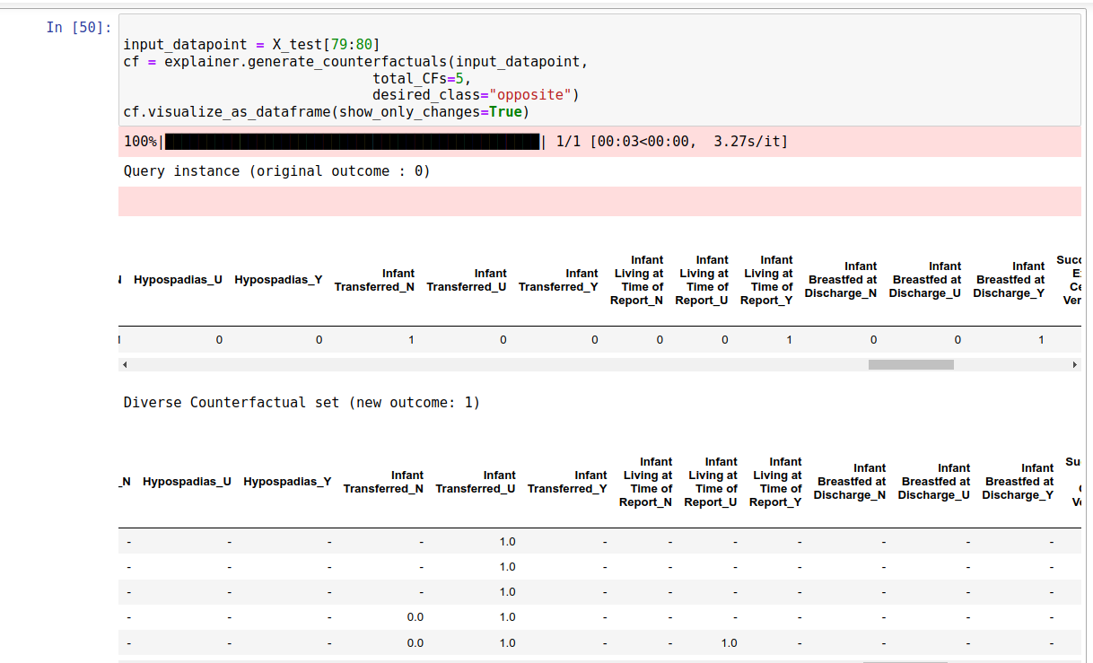
FEATURES CHANGE : 0→1 ( Abnormal -> Normal)
Conclusion: Below Features need to be consider to get “Normal conditions”.
Month Prenatal Care Began should be increased or upto 79.3.
Body Mass Index should be increased > 26.69.
Infant Transferred_U = 1.0, should be done.

Slide 12
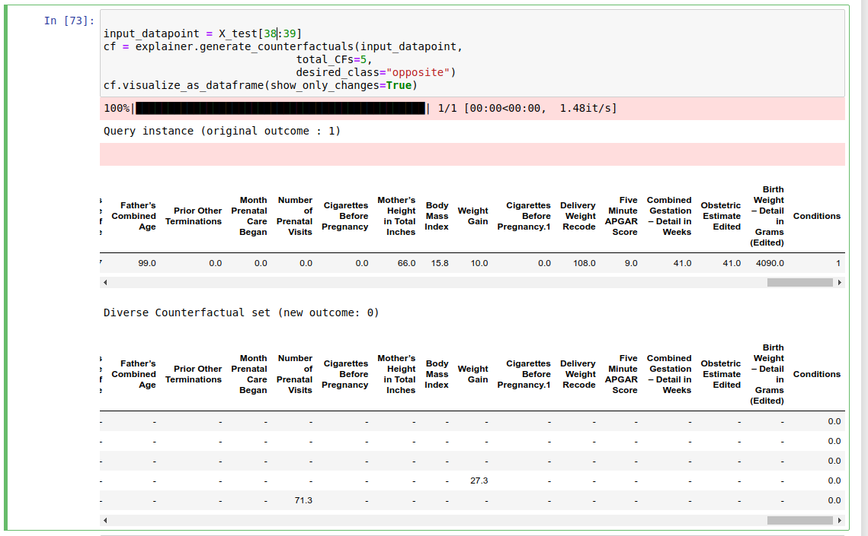
COUNTERFACTUAL GENERATIONS :
CLASS CHANGE : 1 ( Normal Cond. ) —> 0 ( AbNormal Cond. )
Now you are falling into Normal cond. But there is possibility to get Abnormality.
Class changes : “1” : Normal Conditions ,
“0” : Ab Normal Conditions.

Slide 13
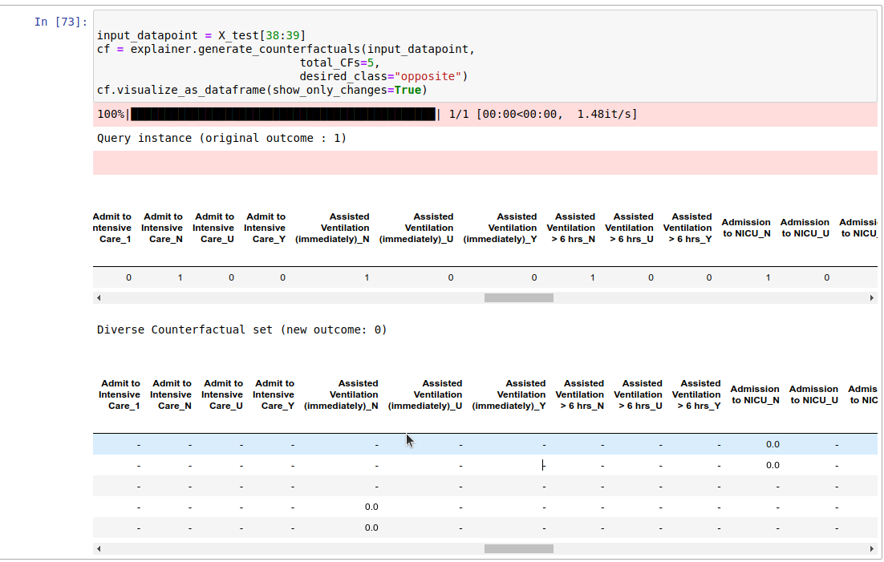
FEATURES CHANGE : 1 ( Normal Cond )→0 ( Ab Normal Cond ).
Features Change you will fall into Abnormal Condition, if
“NO. of Prenatal Visits Increased at least < 71.3,
“Weight Gain” is to increased ( < 27.3 ).
If there is No Assisted Ventilation (Immediately).
If there is No Admission to NICU.

